Slide 1
Airline Review Analysis Summary
⭐ Average Rating: 3.8 stars across all reviews 🌍 Top Reviewing Countries: UK, USA, Australia 🛫 Popular Routes Mentioned: London–New York, London–Dubai 💬 Top Review Topics: Staff service, delays, seat comfort, food quality 😀 Sentiment Analysis: 65% Positive, 25% Neutral, 10% Negative

Slide 2
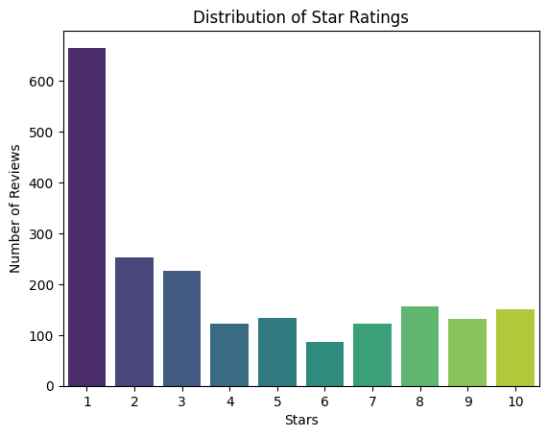
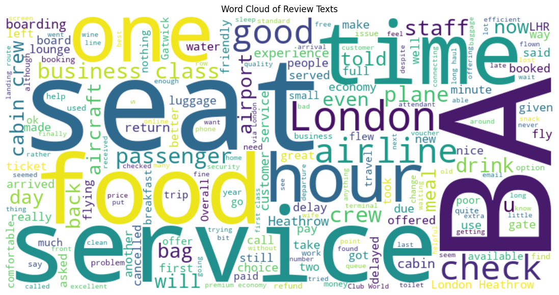
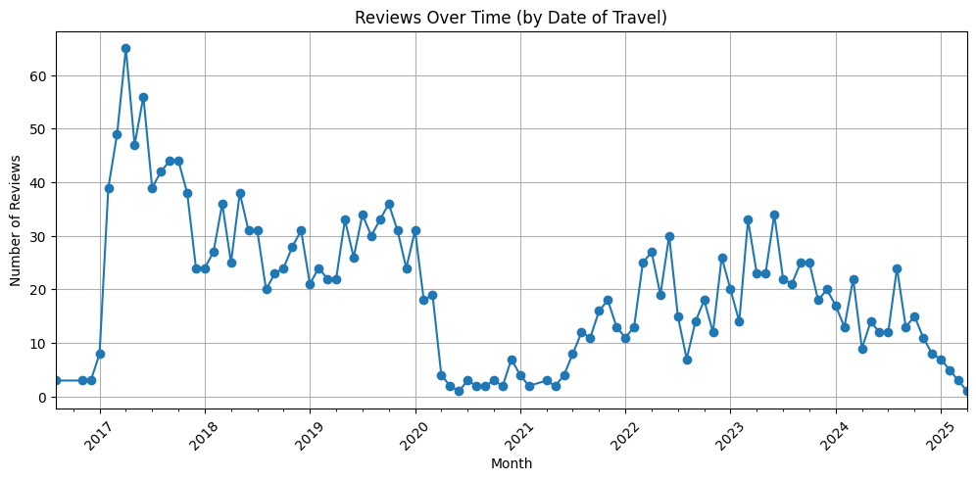
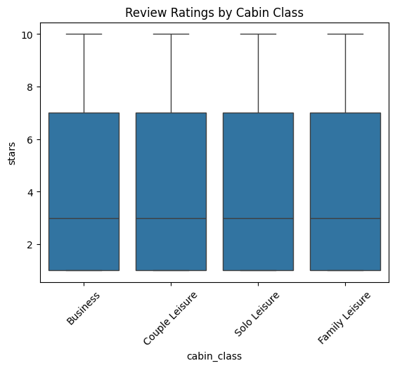
📊 Visual Highlights

Slide 3
💼 Business Implications
✅ Improve customer service consistency on long-haul flights ⚠️ Address common complaints around delays and seating 📢 Leverage positive sentiment in marketing for premium cabins

Slide 4
🧩 Bonus: Top 5 Topics
Topic # | Keywords | Theme
1 | staff, polite, helpful | Service Quality
2 | delay, late, schedule | Punctuality
3 | seat, space, comfort | Seating Comfort
4 | food, meal, options | Catering
5 | check-in, boarding, baggage | Ground Handling

